Slide 1
ITIL® 2011 Foundation Certification Course
Unit 5—Service Operations

Slide 2
Service Operations
Lesson 1—Introduction to Service Operations

Slide 3
Objectives
Describe the purpose, objective and scope of service operations phase
List the principles of communication
Explain events, alerts and incidents
After completing this lesson, you will be able to:

Slide 4



Service Operations—Purpose
Service operations is responsible for the delivery of services to the required standard.
The purpose of service operations is to:
coordinate and carry out activities and processes;
deliver and manage services at agreed levels to meet user and customer needs; and
manage technology that is used to deliver and support services.
Purpose
Objective
Scope

Slide 5
Service Operations—Objective
The objective of service operations is to:
maintain business satisfaction;
deliver effective and efficient IT services;
minimise the impact of service outage; and
ensure access to IT services for only authorised users.
Purpose
Objective
Scope

Slide 6
Service Operations—Scope
Service operations provides guidance in following areas:
Services or activities that form part of a service and are included in service operation;
Service management processes or on-going management and execution processes that are performed in service operation;
Technology required by all services; and
People who manage all processes and technology, and drive the demand for the organisation’s services and products.
Purpose
Objective
Scope

Slide 7
Role of Communication
Good communication is a part of every organisation. Following are few important principles of communication:
It must have an intended purpose or a resultant action.
It should not take place unless there is a clear audience.
It should include active participation of the audience.

Slide 8
Types of Communication
There are some types of communication typical to service operations. They are:
Routine operational communication
It includes incident tickets resolved on time and communication between service desk and users or technical teams.
Communication between shifts
Communication between shifts include the shift handover reports.
Performance reporting
Performance reporting is the communication related to emergencies like outage or service downtime notifications to users and customers.
Training
Training on new or customised processes and service designs is another form of communication related to service operation.

Slide 9
Events
Event can be defined as any change of state of a CI or component of the service that is relevant to the delivery of the service. Events can be classified into three types:
Informational events
They indicate a normal operation.
Example: A user has logged on to use an application.
Warning events
They signal an unusual but not exceptional operation.
Example: Utilization of a server’s memory reaches within five per cent of its highest acceptable level.
Exceptional events
They indicate an abnormal operation.
Example: A user tries to log on to an application with an incorrect password.

Slide 10
Alerts and Incidents
Following are the facts related to alerts and incidents:
Alerts
Incidents
It is a warning that a failure has occurred.
They are often created and managed by system management tools.
They are managed by the event management process.
Example: When you login to a bank's website or perform a transaction there, you receive an email alert
It is an unplanned interruption to an IT service.
It is a reduction in the quality of an IT service.
Incidents are managed by incident management process.
Example: Failure of an IT component that has not yet affected service
All alerts are events, but not all events trigger alerts.
All incidents are events, but not all events are incidents.

Slide 11
Problems and Workarounds
The process of managing problems and their workarounds is called problem management.
Problems
Workarounds
Cause of one or more incidents or potential incidents, which may not be known at the time of occurrence; can be classified and categorised as incidents
Are documented in problem records
Temporary way to restore service failures to an operational level
Are documented in known error records

Slide 12
Known Error and Known Error Database
Following are the facts related to Known Error and Known Error Database:
Known Error
Known Error Database
When a workaround or an unresolved root cause of a problem is found, it is called a Known Error.
Known errors are managed by problem management process.
Development teams may also identify them.
The database created for known errors and their solutions is called Known Error Database (KEDB).
It helps in faster diagnosis and resolution of incidents, by implementing a workaround.
Gives details of the fault and the symptoms.

Slide 13
Priority
Priority is the relative importance of an incident, problem or change. Priority is calculated based on impact and urgency of the issue.
Impact is the measure of effect the issue has on a business process.
Urgency is the time taken to resolve the issue.
Priority = Impact + Urgency

Slide 14
Summary
The purpose of service operations is to coordinate and carry out activities and processes.
Any communication must have an intended purpose or a resultant action. It should include active participation of the audience.
There are three types of events–informational, exceptional and warning.
The process of managing problems and their workarounds is called problem management.
Here is a quick recap of what we have learnt in this lesson:

Slide 15
Service Operations
Lesson 2—Service Operations Processes

Slide 16
Objectives
Explain the purpose, objective, scope, value and basic concepts of the processes of service operations
After completing this lesson, you will be able to:

Slide 17
Event Management—Purpose
Event management is the basis for operational monitoring and control.
The purpose of event management is to:
detect events;
ensure that an appropriate control action is coordinated; and
manage these events throughout their lifecycle.
Purpose
Objective
Scope

Slide 18
Event Management—Objective
The objective of event management is to:
detect all changes that are significant for the management of a CI (Configuration Item) or IT service;
determine the appropriate control action or events;
provide means to compare actual operating performance and behavior; and
provide a basis for service assurance, reporting and service improvement.
Purpose
Objective
Scope

Slide 19
Event Management—Scope
The scope of event management is to:
configure items;
detect environmental conditions;
monitor software licenses to ensure optimum or legal utilization and allocation;
maintain security; and
ensure activities such as mainframe utilization and batch jobs are carried out.
Purpose
Objective
Scope

Slide 20
Event Management–Process Activities
Following is the process flow of activities associated with event management:
Event
Occurs
Event
Notification
Event
Detection
Event
Logged
First-level
Event correlation
Second-level
Event correlation
Further
Warning
Significance
Action
Response
Selection
Review
Action
Close Event

Slide 21
Event Logging and Filtering
Events occur continuously in an organisation. When an event is generated:
It is detected by an agent known as trap.
It is filtered and decided whether to be treated or ignored.
If ignored the event is recorded in a log file on the device.
If not ignored, first level correlation is performed.
Event
Exception
Warning
Information
Filter

Slide 22
Manage Exceptional Events
If the output of filtering is an exception, it means that a service or device is currently operating abnormally.
Exceptions can represent a total failure, an impaired functionality or a degraded performance.
An exception can be managed by using either an incident record or a request for change or even both.
Incident
Incident
Management
Incident/
Exception
Problem/
Problem
Problem
Management
Change
RFC
Change
Management
© Crown Copyright 2011. Reproduced under licence from AXELOS.

Slide 23
Manage Informational and Warning Events
If the output of filtering is informational, the event does not require any action. It can be stored in a system or service log. Such events are used to check the status of a service or device and confirm the completion of an activity.
Examples of informational events:
a device has come online;
a job in the batch queue has completed successfully;
a user logs onto an application; and
a transaction has completed.

Slide 24
Manage Informational and Warning Events (contd.)
A warning output is generated when a service or device is approaching a predefined threshold. Warnings are usually not raised for a device failure.
Example:
The memory utilization on a server is currently at 65% and it is increasing. If it reaches 75%, response time will be excessively long and the OLA for that department will be breached.

Slide 25
Manage Informational and Warning Events (contd.)
The image illustrates how an informational event and a warning are handled. If an event is an informational event, it is simply logged. But if the event is a warning, there are two ways to handle it. If any manual interference is needed, the concerned team needs to log the incident and work on it. If the warning is automated, the event is handled by the CI and it is logged before being closed.
Incident
management
Do any one or combinations
of…
Incident/
problem/
Problem
management
change
Warning event
Change
management
Alert
Human
intervention
Auto
response
Informational event
Log
© Crown Copyright 2011. Reproduced under licence from AXELOS.

Slide 26
What are the three broad level categorisation of events?
Information, exception and warning
Information, example and warning
Interaction, exception and warning
Information, exception and notice

Slide 27
What are the three broad level categorisation of events?
Information, exception and warning
Information, example and warning
Interaction, exception and warning
Information, exception and notice
Answer: a.
Explanation: There are three broad levels of categorisation: informational, warning and
exception.

Slide 28




Incident Management—Purpose
The process of dealing with all the incidents throughout its lifecycle is known as incident management.
The purpose of incident management is to:
restore normal service operations as soon as possible;
minimise adverse impact on business operations; and
ensuring best possible levels of service quality and availability.
Purpose
Objective
Scope
Value

Slide 29



Incident Management—Objective
Following are the objectives of incident management process:
To ensure standardisation methods and procedures used for efficient and prompt response.
To analyse, document and report incidents during management process.
To increase visibility and communication of incidents to business and IT support staff
To align incident management activities and priorities with those of the business.
Purpose
Objective
Scope
Value

Slide 30
Incident Management—Scope
Managing any disruption or potential disruption to live IT services is the primary scope of incident management. It also comprises events identified:
directly by users through service desk;
through an interface from event management to incident management tools; and
reported or logged by technical staff.
Purpose
Objective
Scope
Value

Slide 31
Incident Management—Value for Business
Incident management adds the following values to business:
It lowers downtime for the business, which in turn leads to higher availability of the services.
It improves the capability to identify business priorities and dynamically allocate resources as necessary.
It increases the ability to identify potential improvements to services.
Purpose
Objective
Scope
Value

Slide 32
Incident Management–Basic Concepts
Following are the basic concepts of incident management:
Time scales
Depend on the priority defined
Should be documented in Operational Level Agreements and Underpinning Contracts
Based on predefined steps to handle a particular incident
Detailed description of steps
Incident models
A break in service which threatens to cause or may cause a loss to the business
A separate procedure including shorter timescales and greater urgency is used
Major incidents

Slide 33
Incident Management–Process Flow
The incident management process flow consists of the following steps.
Event
Management
Incident
Identification
To request fulfilment (if service change request) or service portfolio management (if it is a change proposal)
Major Incident Procedure
Yes
Functional
Escalation
Web
Interfaces
Is This
No
Yes
Really an
Major
Functional
Incident?
Incident?
Escalation?
No
User Phone Call
Yes
No
Hierarchic
Incident
Logging
Initial Diagnosis
Escalation?
Email Technical Staff
Yes
Incident
Categorisation
Escalation
No
Management
Escalation
No
Needed?
No
Investigation and Diagnosis
Incident
Prioritisation
Incident Closure
Resolution
Identified?
Resolution and Recovery
© Crown Copyright 2011. Reproduced under licence from AXELOS.
Yes
End

Slide 34
Incident Management—Example
Q
A small organisation has the following Configuration Items (CIs): 10 Windows and 2 email servers, 20 switches, 5 routers, 2 video conferencing units. The two email servers (server 1 and server 2) are the parents for the routers, namely, router 1 and router 2, which are parents for all the switches. The remaining servers and routers are serving for a different service. A firmware has been upgraded recently, and the server is restarting itself periodically. The flowchart shows how incident management is implemented.
Incident raised- server-frequent restart
Incident is acknowledged
Validation
Release is raised
Incident is logged
Incident is validated for its information
Impacted CIs
Is this a service request?
No
CI's impacted—server 1
Stakeholder impacted
Teams impacted— Network Team
Is this a major incident?
No
Initial diagnose
Diagnose steps
Was there any change in the server?
Yes
Understanding the cause
Understand the change and upgrade firmware
Server working normally before change
Yes
KEDB referral
Any articles on KEDB for this
No
Raise a change to revoke it
Troubleshooting
Yes
Try applying the resolution
Check if the server is normal
Confirmation and closure
Inform the user about the resolution
Confirm with the user
Close the incident

Slide 35
Process Interfaces
Following are the interactions incident management has with other processes for its day-to-day activities.
Service
SLAs, OLAs, UCs
Level
Service break/degrading events
Management
Event
Management
Performance incidents
Incident workarounds
Capacity
Management
Incident Management
Problem
Potential problems
Management
Availability incidents
Availability
Management
RFC for resolving incidents
Incidents from failed changes
Change
Management
CI data
Maintain faulty CI Status
SACM*
*SACM: Service Asset and Configuration Management
© Crown Copyright 2011. Reproduced under licence from AXELOS.

Slide 36
Problem Management—Purpose
The process responsible for managing the lifecycle of all problems is known as problem management.
The purpose of problem management is to:
identify and eliminate root cause of incidents in the IT infrastructure;
eliminate recurring incidents; and
minimise the impact of incidents that cannot be prevented.
Purpose
Objective
Scope
Value

Slide 37
Problem Management—Objective
Following are the objectives of problem management:
To prevent problems and resulting incidents from taking place.
To eliminate recurring incidents.
To fix the root cause and minimise the impact of the incidents.
Purpose
Objective
Scope
Value

Slide 38
Problem Management—Scope
Following is the scope of problem management:
To diagnose the root cause of incidents.
To determine the resolution to the problems.
To ensure that the resolution is implemented through the appropriate control procedures.
To maintain information about problems.
Purpose
Objective
Scope
Value

Slide 39
Problem Management—Value for Business
Following are the values problem management adds to business:
Adds improvement to IT service availability.
Reduces downtimes and disruptions of business critical systems.
Reduces expenditure on workarounds or fixes that do not work.
Reduces cost of effort in resolving repeating incidents.
Purpose
Objective
Scope
Value

Slide 40
Types of Problem Management Processes
The two sub-processes of problem management are:
Reactive problem management
Proactive problem management
Analyses and resolves cause of incidents
Actual root-cause and analysis performed
Known Errors are corrected
Activities are similar to those of incident management
Detects and prevents future problems or incidents
Identification of trends or potential weaknesses
Two types: Trend Analysis and Targeting Preventative Action

Slide 41
What are the two types of proactive problem management processes?
Trend Analysis and Trend Prevention Action
Trend Analysis and Targeting Preventative Action
Target Analysis and Targeting Preventative Action
Trend Setting and Targeting Preventative Action

Slide 42
What are the two types of proactive problem management processes?
Trend Analysis and Trend Prevention Action
Trend Analysis and Targeting Preventative Action
Target Analysis and Targeting Preventative Action
Trend Setting and Targeting Preventative Action
Answer: b.
Explanation: The two types of Proactive Problem management are Trend Analysis and Targeting Preventative Action.

Slide 43

Reactive Problem Management—Process Flow
Following is the simple process flow of reactive problem management.
Problem Detection
and Logging
Problem Categorisation and Prioritisation
Problem Investigation and Diagnosis
Problem Resolution and Closure
Workarounds and Raising Known Error Records
Known Error Database
Major Problem Reviews
Errors from Development/Suppliers

Slide 44
Problem Management—Interface with Other Processes
Problem management integrates with the below processes for its day-to-day activities.
Change management
Problem Management
Availability management
SACM
Capacity management
R&D management
Service level management
IT Service Continuity
Finance management

Slide 45
Request Fulfilment—Purpose
The process of dealing with service requests is known as request fulfilment.
The main purpose of request fulfilment is to manage all service requests raised by the users throughout the lifecycle.
Purpose
Objective
Scope

Slide 46
Request Fulfilment—Objective
Following are the objectives of request fulfilment:
Maintain user and customer satisfaction through efficient and professional handling.
Provide a channel for users to request and receive standard services.
Source and deliver the components of requests.
Assist the customer with general information, complaints or comments.
Purpose
Objective
Scope

Slide 47
Request Fulfilment—Scope
The scope of request fulfilment process is to:
separate work stream; and
record and manage them as a separate record type.
Purpose
Objective
Scope

Slide 48
Service Request
Service request is a key term in service operations. Most of the times, incidents are of low priority. So a separate process can handle them better. Example:
request to change a password;
unlock accounts; and
install an approved software application onto a PC.

Slide 49
Access Management—Purpose
Access management is the operational enforcement of the policies defined by information security and availability management.
The purpose of access management is to:
grant authorised users the right to use a service; and
prevent access to non-authorised users.
Purpose
Objective
Scope

Slide 50
Access Management—Objective
The objective of access management is to execute policies and actions defined by Information Security Management and availability management.
Purpose
Objective
Scope

Slide 51
Access Management—Scope
The scope of access management is to enable the organisation to manage the confidentiality, integrity and availability of their data and intellectual property.
Purpose
Objective
Scope

Slide 52
Summary
Event management is the basis for operational monitoring and control.
The process of dealing with all the incidents throughout its lifecycle is known as incident management.
The three basic concepts of incident management are: Time scales, Incident models and Major incidents.
Problem management has two sub processes: reactive problem management and proactive problem management.
The process of dealing with service requests is known as request fulfilment.
Access management is the operational enforcement of the policies.
Here is a quick recap of what we have learnt in this lesson:

Slide 53
Service Operations
Lesson 3—Functions

Slide 54
Objectives
Explain the purpose and objective of the service desk function
Describe the types of service desk functions
Identify the purpose, objective and role of various functions in service operations
After completing this lesson, you will be able to:

Slide 55


Service Desk—Purpose
The service desk is a functional unit that deals with service events such as requests, incidents or information calls.
The purpose of service desk is to:
provide better IT services for customers;
make IT services easily accessible through a single point of communication and minimise negative impact on the business;
provide faster turnaround of customer or user IT requests; and
give enhanced focus and a proactive approach to IT service provisioning.
Purpose
Objective

Slide 56


Service Desk—Purpose (contd.)
The purpose of service desk is also to:
generate meaningful management information for decision support;
improve teamwork and communication among the IT staff; and
improve the usage of IT support resources to increase the productivity of business personnel.
Purpose
Objective

Slide 57


Service Desk—Objective
The objective of service desk is to:
restore normal service to users by coordinating resolution processes;
operate as a single point of contact for incident management and request fulfilment; and
manage user communication and technical and hierarchical escalations; and
conduct customer and user satisfaction surveys.
Purpose
Objective

Slide 58





Local Service Desk
Local service desk is a form of service desk that is usually located geographically close to its users.
Benefit: It helps in communication and gives a clearly visible presence to the user community.
Downside:
It may be inefficient and expensive to resource due to low call volumes.
Local Users
Service Desk (local)
Third Party
Application
Infrastructure
Support
Support
Support
© Crown Copyright 2011. Reproduced under licence from AXELOS.

Slide 59
Local Service Desk (contd.)
Following are the reasons why local service desks are used:
There may be cultural, linguistic and political differences between user communities.
The user communities may operate in various time zones.
There are specialised user communities such as one working on Apple computers whereas others working on Windows.
Organisations need a dedicated service desk for the corporate headquarters and another for their field offices.

Slide 60

Centralised Service Desk
The centralised service desk is a form of service desk where several service desks are merged into one or fewer locations. It serves a community of users in different locations.
Benefits:
It reduces the total number of service desks utilised, so it is cost-effective and efficient.
Only a fewer number of staff is needed to handle a high volume of calls.
Customer
Customer
Customer
site 1
site 2
site 3
Service Desk (centralised)
Second-Line Support
Third Party
Support
Application
Support
Infrastructure
Support
© Crown Copyright 2011. Reproduced under licence from AXELOS.

Slide 61






Virtual Service Desk
The virtual service desk gives the impression of one centralised service desk at work, wherein the service desk personnel may be located across a number of geographical areas or structural locations.
Through a single email, contact phone number or ticket management system, the service desk personnel may appear to be located at the same geographical or structural location to the user.
Singapore
London
Virtual
Service Desk
Tokyo
San Francisco
Third party Supplier
Configuration Management
© Crown Copyright 2011. Reproduced under licence from AXELOS.

Slide 62
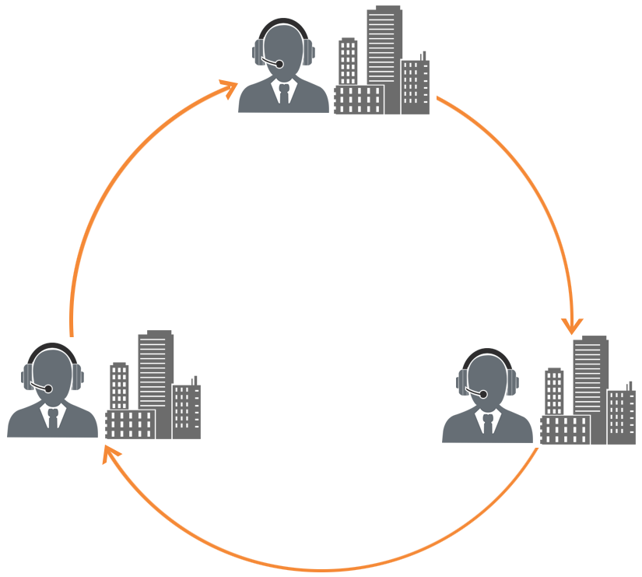
Follow-The-Sun Service Desk
The Follow-The-Sun service desks are located in different time zones so that wherever the sun is shining, the service desk in that part of the globe takes up the service.
European service desk
Asia-Pacific service desk
US-based service desk

Slide 63
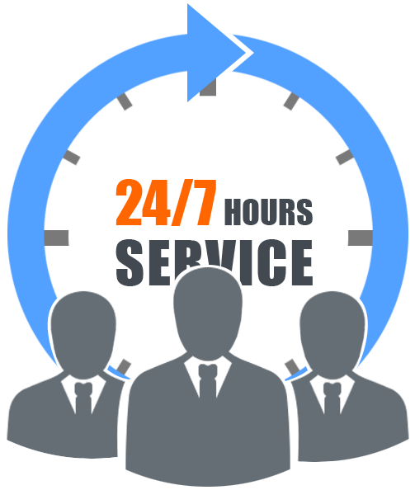
Specialised Service Desk
The specialised service desk is created by forming a specialist group within the service desk framework.
Benefit:
It helps in faster resolution of incidents because the specialist group is trained in handling such issues on a daily basis.
Example:
An Admin helpdesk that handles administration related queries or a Payroll department that takes care of payroll related queries

Slide 64

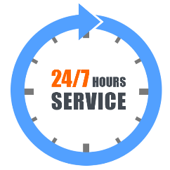


Service Desk Staffing
Service desk staffing is based on the following criteria:
Customer expectations
Number of users
Coverage period
Processes followed
When planning for a service desk, the customer expectations from the service desk should be understood from the call response time that tells how responsive they want the service desk to be.
The number of service desk staff is calculated based on the number of users and also keeping in mind the language and culture of the user community.
This means deciding upon the service desk staffing based on whether the service desk works 24X7 or is available only during working hours, out-of-hours and so on.
Service desk staffing is also based on whether the service desk knows how to handle escalations, how the shifts are managed and so on.

Slide 65
Service Desk—Skills Required
The service desk staff needs to have abilities such as:
communication skills to ensure that they give customers a positive perception of their IT services;
technical skills for diagnosis and issue resolution; and
business understanding for prioritisation of issues.

Slide 66
Service Desk Metrics
Service desk needs periodic evaluation to improve the service. The evaluation is done by measuring Key Performance Indicators (KPIs) or metrics.
Some of the service desk metrics are:
first-line resolution rate, that is, how many issues were resolved by the service desk during the first call;
average time taken to resolve and/or escalate any incident, which indicates how responsive the service desk is; and
ratio of total cost for the period to the total call duration expressed in minutes, which indicates how cost-effective the service desk interaction is.

Slide 67
Service Desk Metrics (contd.)
Other service desk metrics are:
the number of calls broken by the time and the day of week, along with the average call time; and
customer or user satisfaction surveys that indicate how satisfied the user community is with the service desk.

Slide 68



Technical Management—Purpose
Technical management is the department that provides technical expertise and manages the overall IT infrastructure.
The purpose of technical management is to:
plan, implement and maintain the technical infrastructure supporting the business processes; and
provide hands-on skills supporting the IT infrastructure.
Purpose
Objective
Role

Slide 69

Technical Management—Objective
The objective of technical management is to:
provide an infrastructure configuration that is well-designed, cost-effective and resilient; and
use technical skills and infrastructure to detect and resolve technical failures.
Purpose
Objective
Role

Slide 70
Technical Management—Role
The role of technical management is to:
act as the custodian of technical expertise required for managing the IT infrastructure;
provide resources to support the activities in the IT Service Management lifecycle; and
make sure that the resources get proper training to design, build, operate and improve the technology required for delivering and supporting IT services.
Purpose
Objective
Role

Slide 71
Application Management—Purpose
Application management performs the same role for applications as technical management performs for IT infrastructure.
The purpose of application management is to:
manage applications for their lifecycle; and
decide whether to buy or build an application.
Purpose
Objective
Role

Slide 72
Application Management—Objective
The objective of application management is to:
identify functional and manageability requirements for the application software that support the business processes; and
provide on-going support in maintaining and improving applications.
Purpose
Objective
Role

Slide 73
Application Management—Role
The role of application management is to:
act as the custodian of technical knowledge for managing applications that are purchased or developed by the organisation;
provide resources that can support the service lifecycle;
guide the IT operations team on the operational management of applications and integrate the application management lifecycle into the service lifecycle.
Purpose
Objective
Role

Slide 74
Application Management vs. Application Development
The table shows a comparison between application management and application development:
Application management | Application development
On-going set of activities performed to oversee and manage applications throughout their lifecycle. | One-time set of activities performed to design and construct application solutions.
Performed for all applications that are purchased or developed by the organisation. | Performed for applications developed by the organisation.
Focuses on both utility and warranty. | Focuses only on utility.
Focuses on both functionality and delivery procedure of the final product. | Focuses on building functionality for customers.
Deals with the manageability aspects of an application. | Deals with the functions of the application rather than how it is operated.

Slide 75
IT Operations Management—Purpose
IT operations management is the function in charge of on-going maintenance and management of IT infrastructure in an organisation.
The purpose of IT operations management is to:
perform actions repeatedly and consistently at the right qualitative level to ensure the success of business operations; and
measure the actual value of the services delivered by the organisation.
Purpose
Objective
Role

Slide 76
IT Operations Management—Objective
The objective of IT operations management is to:
maintain the as-is infrastructure and procedures so that there is stability in the organisation’s daily activities and processes;
scrutinise daily and improve services at a low cost while maintaining stability; and
apply operational skills to detect and resolve failures in IT operations.
Purpose
Objective
Role

Slide 77
IT Operations Management—Role
The role of IT operations management is to:
control operations: monitor the execution of operational activities related to the IT infrastructure, and take care of console management, print and output management, backup and restore, job scheduling and maintenance tasks on behalf of technical or application management teams; and
engage in facilities management: manage the data centre, recovery sites, computer rooms and so on.
Purpose
Objective
Role

Slide 78
Summary
Service desk is a functional unit that deals with service events such as incidents, requests and information calls.
Some of the service desk functions are local, centralised, virtual and so on.
Technical management maintains the technical infrastructure supporting the business processes.
Application management provides consistent support in maintaining and improving applications throughout their lifecycle.
IT operations management detects and resolves the failures in IT operations.
Here is a quick recap of what we have learnt in this lesson:

Slide 80
What is the key purpose of service operation?
1
To decide how IT will engage with suppliers
To prevent all outages to IT services
To design processes so that business needs are satisfied
To deliver IT services at agreed levels to business users and customers

Slide 81
What is the key purpose of service operation?
1
To decide how IT will engage with suppliers
To prevent all outages to IT services
To design processes so that business needs are satisfied
To deliver IT services at agreed levels to business users and customers
Answer: d.
Explanation: The key purpose of service operation is to deliver IT services at agreed levels to business users and customers.

Slide 82
What does major incidents require?
2
Separate procedure
Longer timescales
Less urgency
Less documentation

Slide 83
What does major incidents require?
2
Separate procedure
Longer timescales
Less urgency
Less documentation
Answer: a.
Explanation: Unlike the normal incidents that are addressed using predefined steps, major incidents should be handled differently. So they require a separate procedure.

Slide 84
Which of the following is not the objective of request fulfilment?
3
To inform users about services that are available
To update and maintain the service catalogue
To help users request for and receive services
To source and deliver standard services that are requested

Slide 85
Which of the following is not the objective of request fulfilment?
3
To inform users about services that are available
To update and maintain the service catalogue
To help users request for and receive services
To source and deliver standard services that are requested
Answer: b.
Explanation: Updating and maintaining the service catalogue is not an objective of request fulfilment.

Slide 86
Which service desk offers 24-hour service in different geographical areas?
4
Virtual service desk
Centralised service desk
Follow-the-sun service desk
Specialised service desk

Slide 87
Which service desk offers 24-hour service in different geographical areas?
4
Virtual service desk
Centralised service desk
Follow-the-sun service desk
Specialised service desk
Answer: c.
Explanation: The Follow-the-sun service desk comprises two or more service desks that are located in different geographical areas and offer 24-hour service.

Slide 88
Which of the following is included in IT operations management?
5
Application management and technical management
Technical management and facilities management
IT operations control and facilities management
Application management and network management

Slide 89
Which of the following is included in IT operations management?
5
Application management and technical management
Technical management and facilities management
IT operations control and facilities management
Application management and network management
Answer: c.
Explanation: IT operations management includes IT operations control and facilities management.

